Slide 1
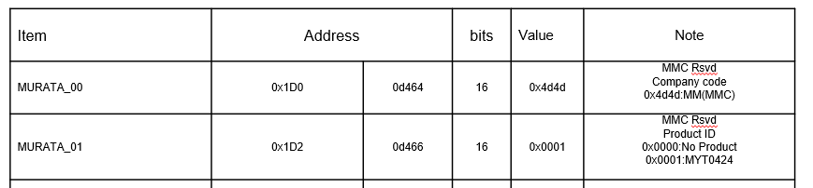
GUI requests for PSiP (using PE24103)
[001]:
1.when GUI set up, check the product ID, which are PMBus’s address 0x1D0 and 0x1D2.
2.Then, product name show MYT0424, if those value are 0x4d4d(addr:0x1D0) and 0x0001(addr:0x1D1).
[002]~[009]:blank items (not shown for user)
Please refer to next page with reference # from [001] to [009]

Slide 2
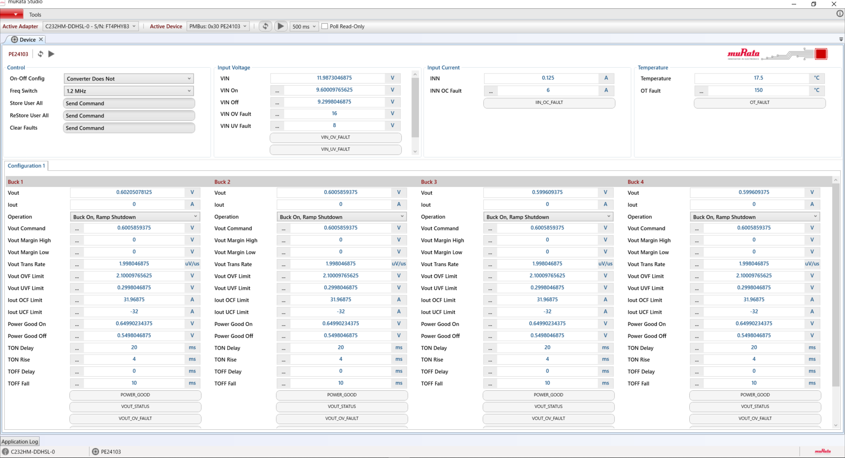
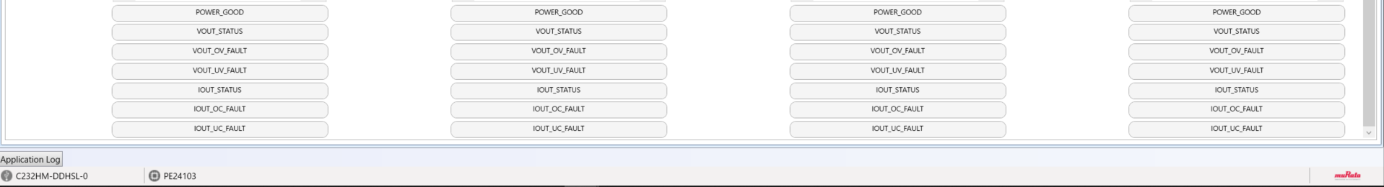
[001]
MYT0424
[002]
[003]
[006]
[004]
[005
[007]
[008]
[009]

